Slide 1

UNIVERSITY INSTITUTE OF ENGINEERING
COMPUTER SCIENCE ENGINEERING
Bachelor of Engineering (Computer Science & Engineering)
Subject Name: Block chain Technology
Subject Code: 20_CST-412
Block chain Architecture
Mapped with CO1
Prepared By:
Er. Ankita Sharma
DISCOVER . LEARN . EMPOWER

Slide 2

Architecture of block chain
The architecture of block chain technology can vary depending on the specific implementation and use case. However, I'll provide a general overview of the key components and architectural elements commonly found in block chain systems:
Distributed Network: A block chain operates on a decentralized network of computers, known as nodes. These nodes communicate with each other to maintain a shared ledger and reach consensus on the state of the block chain.
The distributed nature of the network ensures redundancy, fault tolerance, and resilience against attacks.
Blocks: The block chain consists of a series of blocks, where each block contains a list of transactions or data records. Blocks are linked together chronologically, forming a chain. Each block typically contains a unique identifier (hash) and a reference to the previous block, which ensures the integrity and immutability of the block chain.

Slide 3
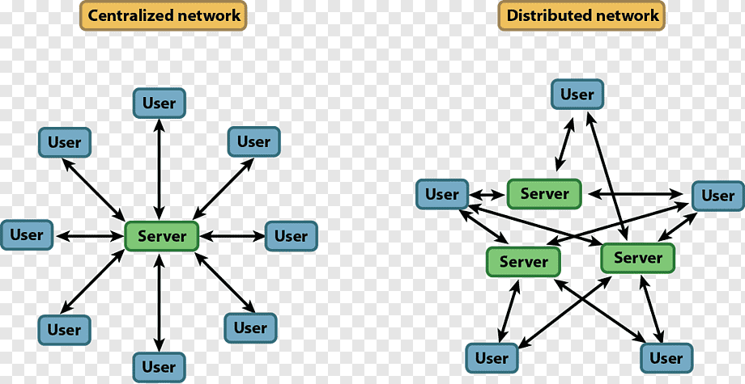
Distributed network and Centralized network

Slide 4

Cryptography: Cryptographic techniques play a crucial role in block chain architecture. Transactions and data records are secured using cryptographic algorithms, such as hash functions, digital signatures, and public-key cryptography. These techniques ensure the integrity, authenticity, and privacy of the data stored on the block chain.
Consensus Mechanism: Consensus mechanisms enable nodes in the network to agree on the validity and order of transactions. Commonly used consensus mechanisms include Proof of Work (PoW), where nodes compete to solve complex mathematical puzzles to validate blocks, and Proof of Stake (PoS), where the probability of validating a block is proportional to the number of tokens held by a node. Other consensus mechanisms like Practical Byzantine Fault Tolerance (PBFT) and Delegated Proof of Stake (DPoS) are also employed in different block chain systems.

Slide 5
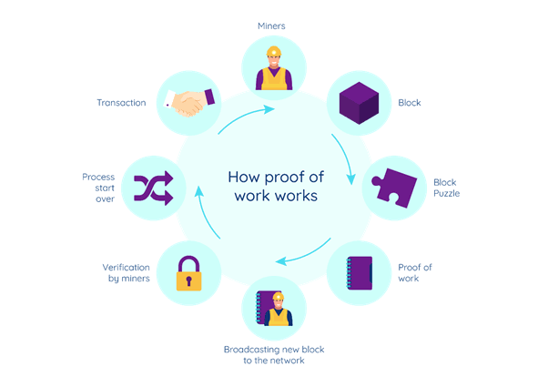

Slide 6
Smart Contracts: Smart contracts are self-executing contracts with predefined rules and conditions encoded on the block chain. They allow for automated and tamper-proof execution of agreements, eliminating the need for intermediaries. Smart contracts are typically written in programming languages specific to the block chain platform (e.g., Solidity for Ethereum) and can interact with the block chain's state and other smart contracts.
Wallets: Wallets are software applications that enable users to securely store and manage their cryptographic keys, which are required to access and transact on the blockchain. Wallets provide a user-friendly interface for interacting with the blockchain, managing digital assets, and initiating transactions.

Slide 7
